Slide 1



COVID-19 Dashboard
Kelly Blake
Rajeshwari Radharkrishna
Aisha Henderson

Slide 2



PROJECT DESCRIPTION
We leveraged available datasets from reliable sources to understand the differences and global impact of COVID-19
The goal of this project was to create an interactive visualization allowing end-users to view and explore Global Covid-19 Data.
For the dashboard, we assessed areas such as:
Total Cases
Total Deaths
Total Vaccinations
New Cases
The CDC Estimates that more than 3 out of 4 Americans have gotten COVID by the end of 2022
- Centers for Disease Control (CDC)

Slide 3
DATASETS USED
Data for this project came from the World Health Organization (WHO)
¹ Daily Cases and Deaths by Date
² Vaccination Data
Project Description
This dataset shows the latest reported counts of cases and deaths for 231 countries and territories globally and is updated weekly.
This dataset shows total vaccinations and boosters for 231 countries and territories globally and is updated weekly.
Field name | Type | Description
Name | String | Country, territory, area
WHO_region | String | WHO Region
Cases - cumulative total | Integer | Cumulative confirmed cases reported to WHO to date.
Cases - newly reported in last 7 days | Integer | New confirmed cases reported in the last 7 days. Calculated by subtracting previous cumulative case count (8 days prior) from current cumulative cases count.
Deaths - cumulative total | Integer | Cumulative confirmed deaths reported to WHO to date.
Deaths - newly reported in last 7 days | Integer | New confirmed deaths reported in the last 7 days. Calculated by subtracting previous cumulative death count (8 days prior) from current cumulative deaths count.
Field name | Type | Description
Country | String | Country, territory, area
WHO_Region | String | WHO regional offices: WHO Member States are grouped into six WHO regions: Regional Office for Africa (AFRO), Regional Office for the Americas (AMRO), Regional Office for South-East Asia (SEARO), Regional Office for Europe (EURO), Regional Office for the Eastern Mediterranean (EMRO), and Regional Office for the Western Pacific (WPRO).
Date_Updated | Date | Date of last update
Total_Vaccinations | Integer | Cumulative total vaccine doses administered
Persons_Vaccinated_1Plus_Dose | Decimal | Cumulative number of persons vaccinated with at least one dose
First_Vaccine_Date | Date | Date of first vaccinations. Equivalent to start/launch date of the first vaccine administered in a country.
Persons_Booster_Add_Dose | Integer | Cumulative number of persons vaccinated with at least one booster or additional dose
03 - PROJECT NAM
¹ https://covid19.who.int/WHO-COVID-19-global-data.csv
² https://covid19.who.int/who-data/vaccination-data.csv

Slide 4
CODING TOOLS
Coding Tools and Database

Slide 5
Coding Tools
Tools | Brief Description
PgAdmin4 – Postgres SQL | Database used to store COVID-19 Data
Python | Utilized functions and DataFrames for database queries
SQLAlchemy | Utilized to connect to data and run queries
HTML & CSS | Webpage formatting and dashboard build
Flask | PgAdmin4 – Postgres SQL
JavaScript Libraries
D3 | Utilized to read in data from flask
Plotly | Utilized for Graphing
Bootstrap | Utilized for visualization of Javascript elements in HTML/CSS
Leaflet | Utilized for Map creation
Several tools were used and much needed in the making of this project…

Slide 6
DATA ANALYSIS
Graphs and Maps Used for Analysis

Slide 7

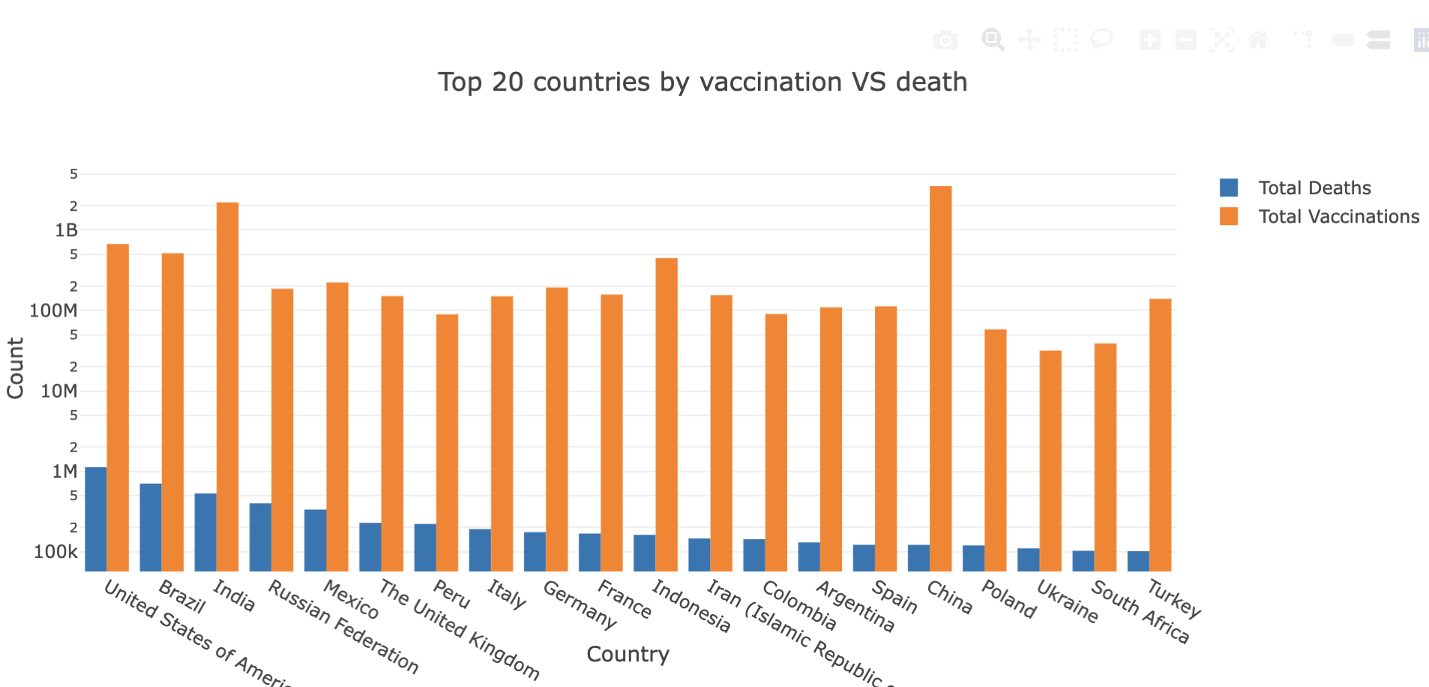
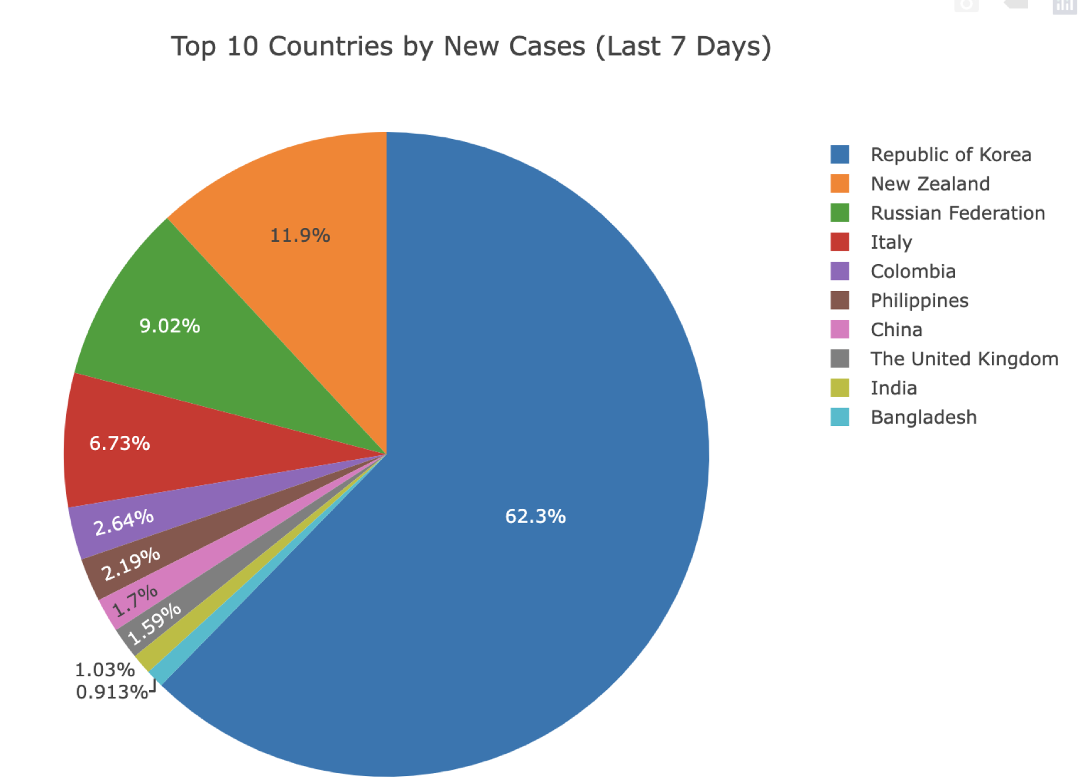

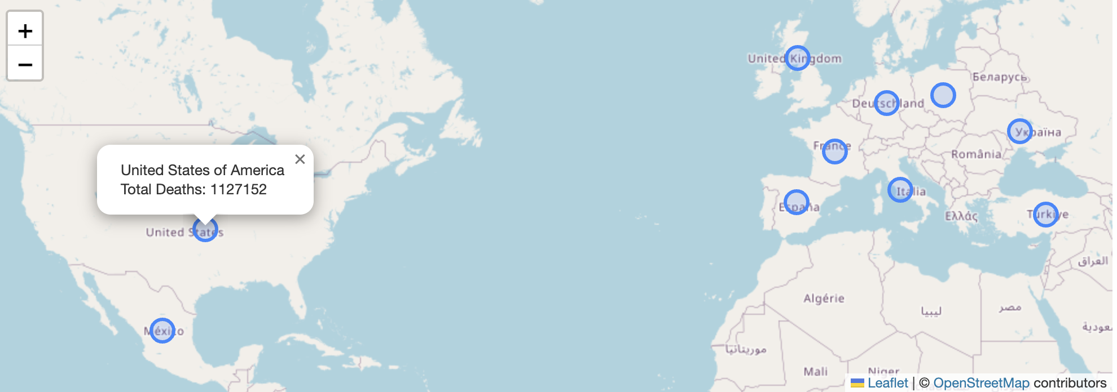

Charts and Maps
Bar Chart
World Map
Pie Chart

Slide 8
CONCLUSION

Slide 9
Final Thoughts…
We leveraged available datasets from reliable sources to understand the differences and global impact of COVID-19
The COVID-19 pandemic has significantly impacted the world, leading to widespread illness, loss of life, and disruptions across various aspects of society
Visualization of relevant data serves as a benefit to those on the front-lines and behind the scenes by providing the most up-to-date information
While we assessed specific items for each country, there are still many layers that could be added to visualize and uncover trends throughout the pandemic.
As the pandemic is still very much ongoing, looking at the data, particularly vaccine data and new cases for each country can help in forecasting and mitigating additional variants or spread of this virus.
For the dashboard, we assessed areas such as:
Total Cases
Total Deaths
Total Vaccinations
New Cases

Slide 10
DASHBOARD DEMO

Slide 11
THANK YOU
www.reallygreatsite.com

